Slide 1
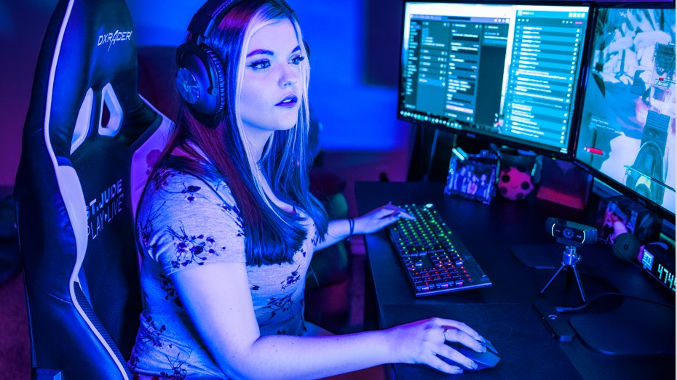
G-sense headsets
Topic: WOW! Wireless gaming
Group: WASN出征寸草不生

Slide 2

GOALS

Slide 3
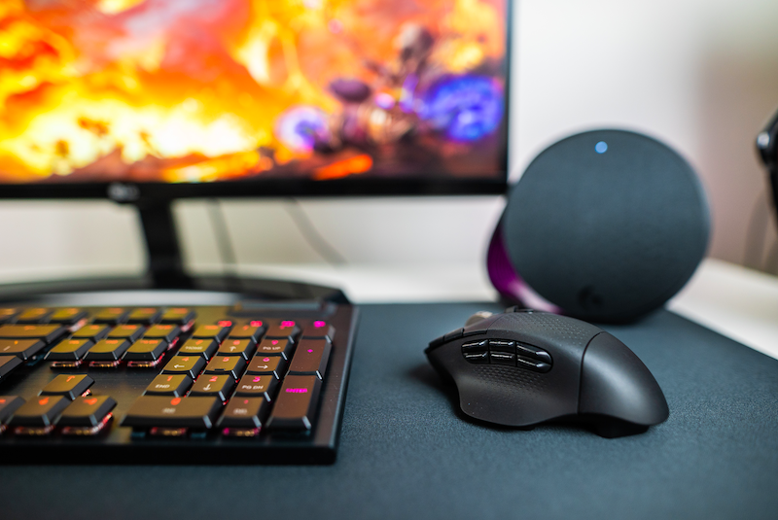
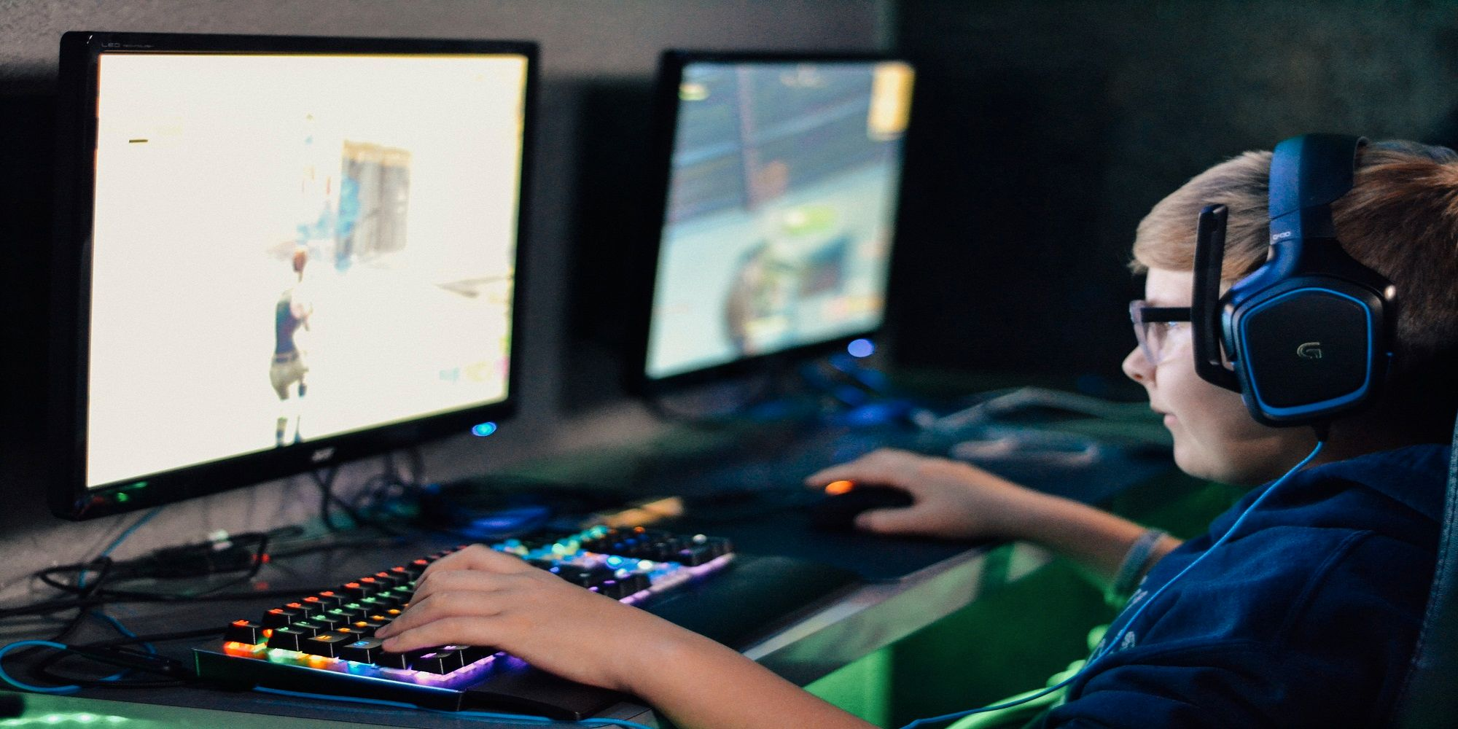
GOALS
Convenience
Comfort
Notes:
Contains two parts we start from two aspects
For streamers, we are to provide convenience with better streaming tools.
For general users, we are to provide comfort for long time or casual gaming.

Slide 4
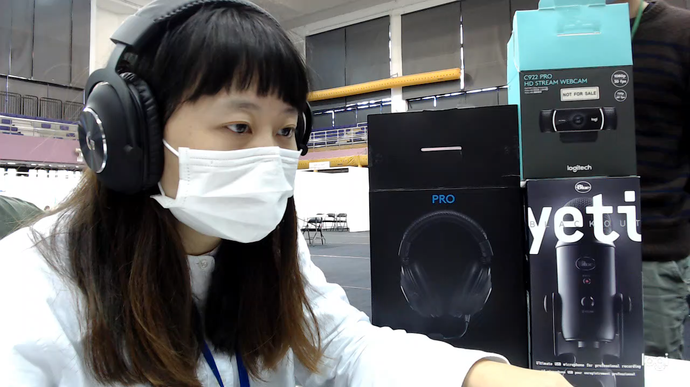
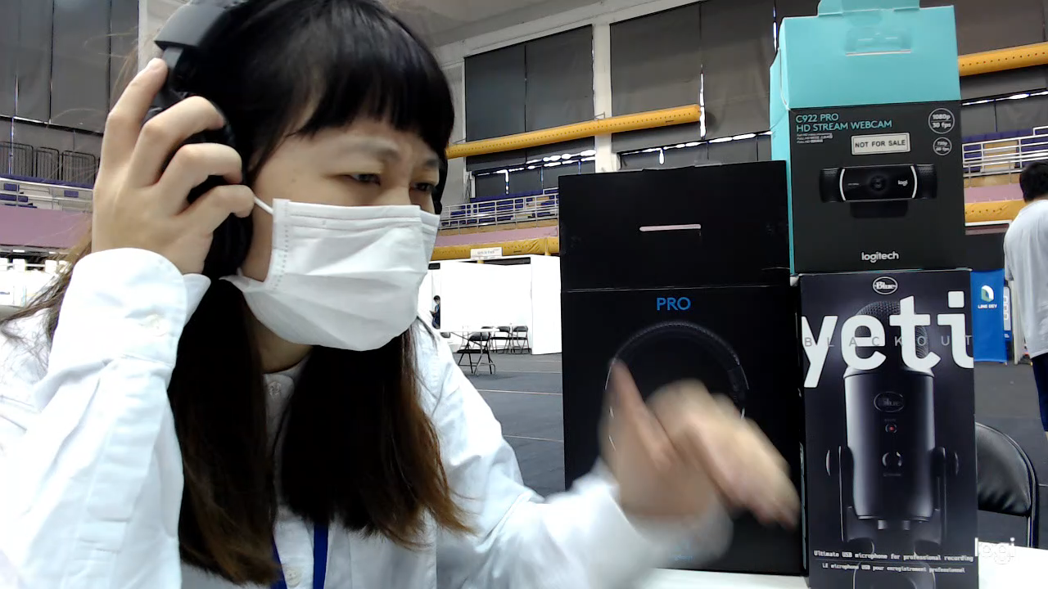
Convenience
Comfort

Slide 5
Solution

Slide 6
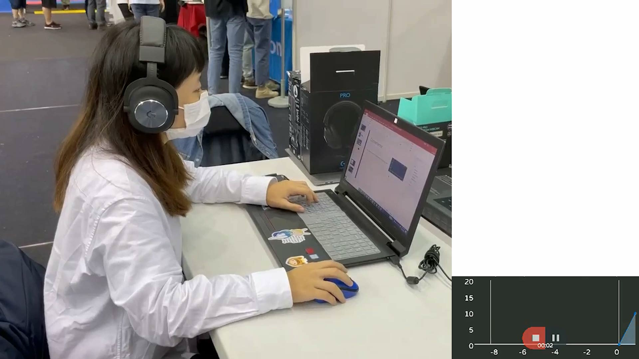
Solution
Gravity-Sensor triggers
audio switching event
Notes:
By user’s action.

Slide 7
Solution
Gravity-Sensor triggers
audio switching event
Notes:
By user’s action.

Slide 8
Future
Notes:
What will g-sense headsets achieve in the future?

Slide 9
Benefits
For streamers:
Smoother streaming
For general users:
Thoughtful design
Notes:
Content creator-friendly
allows streamers to have more time on content creating rather than solving technical issues.
Which all leads to a professional brand image

Slide 10
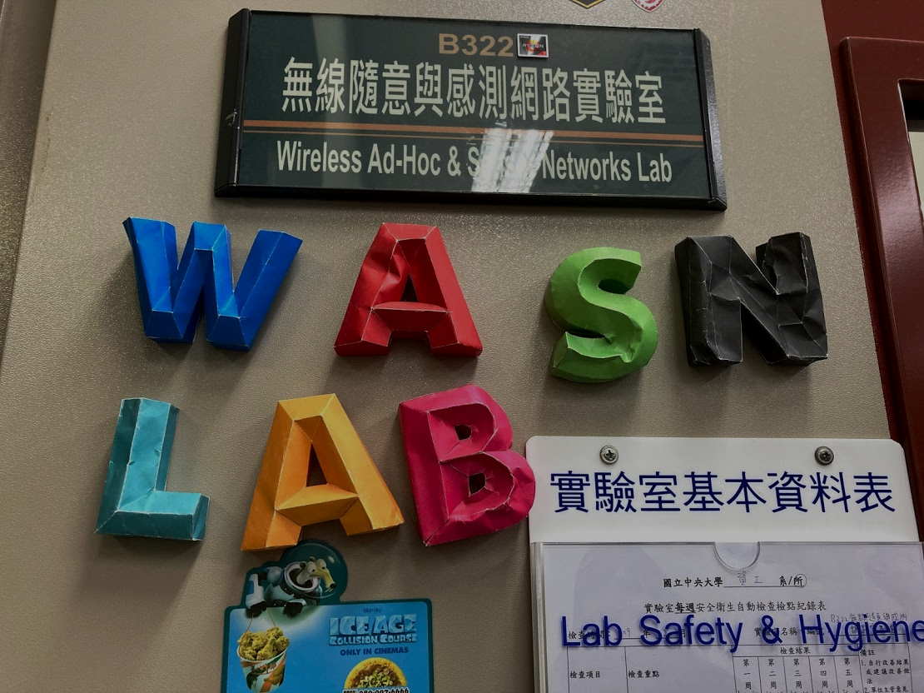
WASN出征寸草不生

